Slide 1
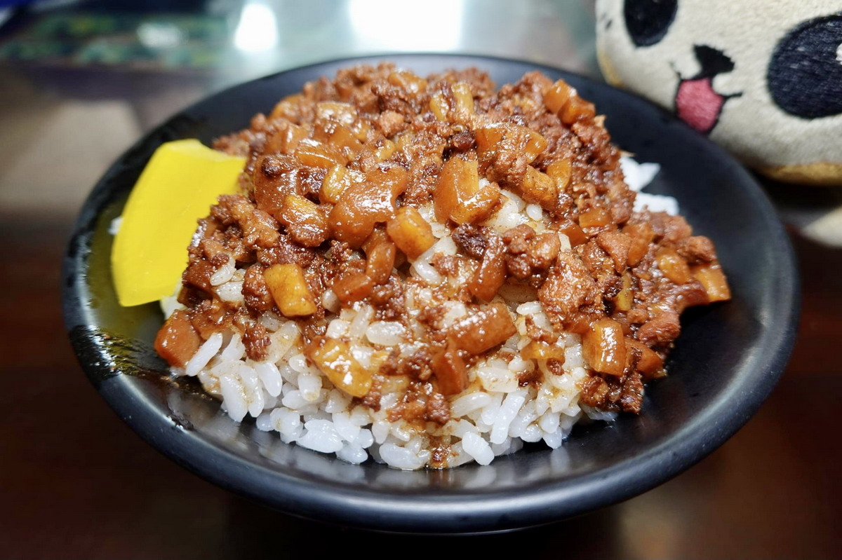





Taiwan Xiao-Chi
Differ between Northern and Southern Xiao-Chi
Northern Xiao-Chi
Southern Xiao-Chi
Shopping List
Lo Bah Png
“Lo Bah Png”, or in Mandarin ”Lu Rou Fan” in northern of Taiwan and “Rou Sao Fan” in southern of Taiwan, is the most most common, popular, and typical cuisine in whole of the Taiwan. Most of the Taiwanese restaurants in everywhere would sell this cuisine. It usually brings Taiwanese a wonderful hometown memory.
“Lo Bah Png” translates to English means braised pork on rice, its flavor may vary depend the region of Taiwan, but basically the ingredients and making process would remain the same: use soy sauce to braise pork.
Recipe
In a POT, heat oil over medium heat. Add shallots and fry until they turn brown. Knead the step 1 for 5 to 10 minutes when it’s turn to a smooth ball and then add the butter to mix evenly.
Add ginger and meat. Stir-fry until the meat is cooked and broken apart. We separate the dough into a small balls for one after the dough arise to twice bigger than the original size.
Add Lo Bah Png spices, soy sauce, wine, sugar, and water.
Cover and cook over medium-low heat for 1 hour, stirring occasionally.
The end product of Lo Bah Png sauce would be a thick sauce, like Bolognese, so you can add everything you like into it. Taiwanese usually would also add tomato, carrot, tofu…etc. into it to make cuisine more sumptuous.
It is very convenient and simple to make a Lo Bah Png sauce, also it is the most typical Taiwanese cuisine. I really do love Lo Bah Png so that I strongly recommend to give it a try if you have a chance to taste it :D
Add it to shopping list!
Taiwan Xiao-Chi
Northern Xiao-Chi
Southern Xiao-Chi
Differ Between northern and Southern Xiao-Chi
Shopping List

